Slide 1

How to mine out a Bitcoin?
Liu Bowen

Slide 2
Do you know…..?
1 Bitcoin = 6153.52 US dollar
2018/10/15 10:00 am

Slide 3

Agenda
You will learn:
Definition of Bitcoin
How to mine out a Bitcoin
Reward from Bitcoin mining

Slide 4
What is Bitcoin?
Crypto-currency
Digital or electronic cash
Without central bank and administrators
Sent from user-to-user
Entity
Transaction: recorded in a public ledger
Block: define information, especially Puzzle
Each block has many transactions

Slide 5
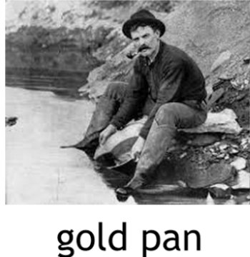
How to mine Bitcoin?
Notes: SUTD Blockchain Technology

Slide 6
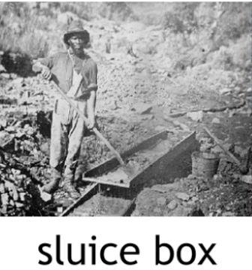
How to mine Bitcoin?
Notes: SUTD Blockchain Technology

Slide 7
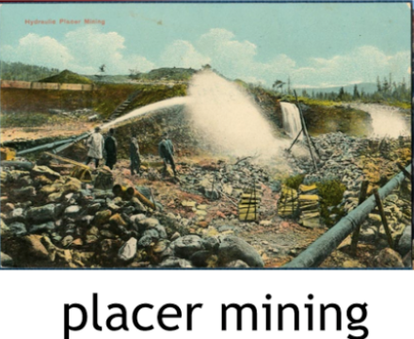
How to mine Bitcoin?
Notes: SUTD Blockchain Technology

Slide 8
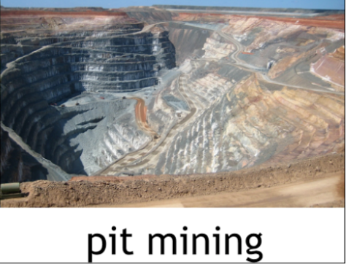
How to mine Bitcoin?
Notes: SUTD Blockchain Technology

Slide 9
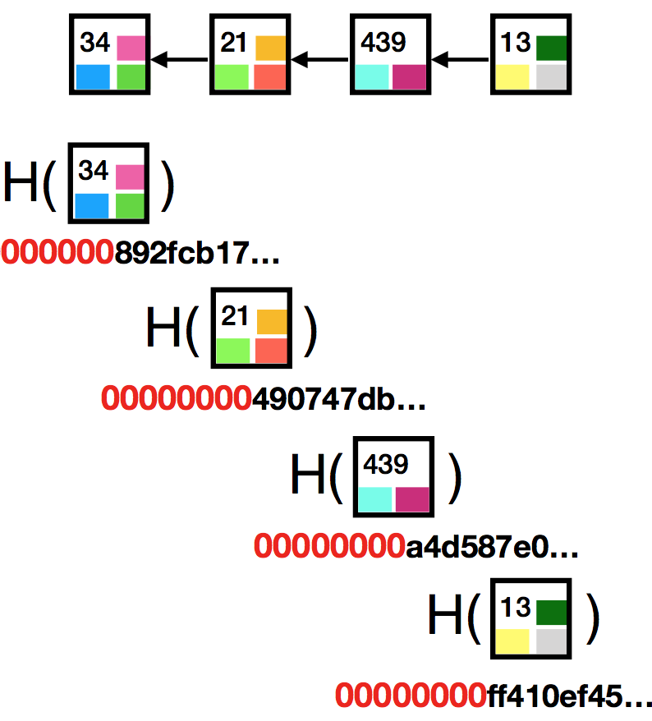
How to mine Bitcoin?
Notes: SUTD Blockchain Technology

Slide 10

Let’s start game!
Individual
Scenario
Transaction: transfer 100 BTC to Nacha
Your task: add transaction into Bitcoin network
Your role: miner
Rules
Task can be done by First person who solve puzzle
First person have award!
Puzzle-solving: complex mathematical problem

Slide 11
Are you ready?

Slide 12
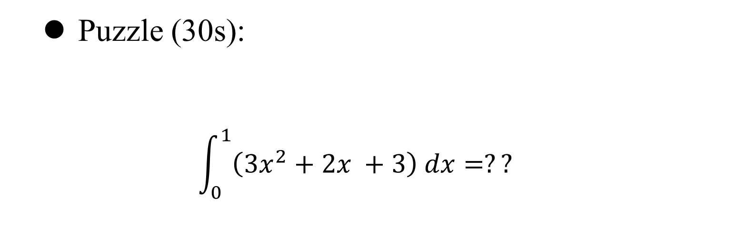
How to mine Bitcoin?
Puzzle (30s):
$$\int_{0}^{1}{\left({3x}^{2}+2x +3\right) dx}=??$$

Slide 13
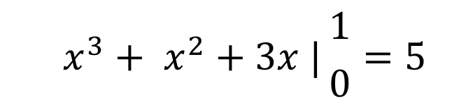
How to mine Bitcoin?
Puzzle (30s):
$$\int_{0}^{1}{\left({3x}^{2}+2x +3\right) dx}=??$$
Answer:
$$x^{3}+ x^{2}+3x |{1 \atop 0}=5$$

Slide 14
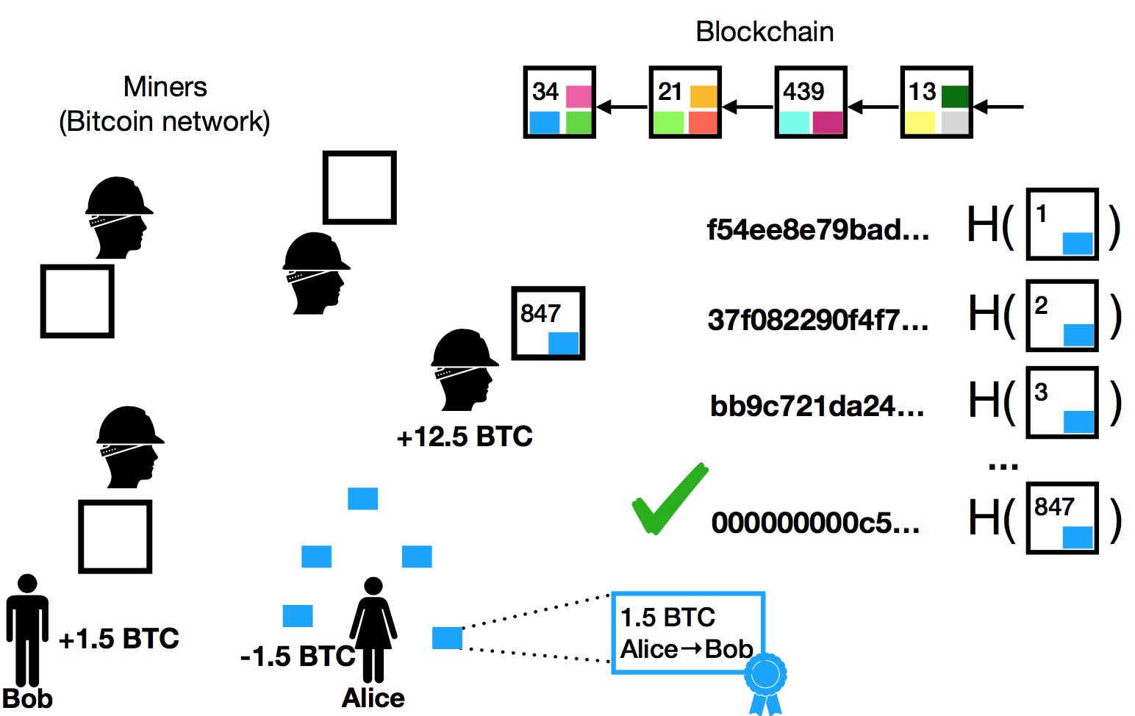
How to mine Bitcoin?
Puzzle tasks
Notes: SUTD Blockchain Technology

Slide 15
Reward of mining?
Fixed income
12.5 BTC from Bitcoin network
Miner’s Expense
Expensive hardware, super-computing, hire miner
Class Game
Bitcoin
Income
cake
12.5BTC
Rules
Integration Puzzle
Cryptography Puzzle
Expense
Your time, calculation
Expensive computer, time
http://bitcoinbook.cs.princeton.edu/

Slide 16
Let's Pop-quiz
Bitcoin is ______
digital currency
entity currency
not any form of currency
____ add transaction into Bitcoin block
Sender
Receiver
Miner

Slide 17
Let's Pop-quiz
Bitcoin is ______
digital currency
entity currency
not any form of currency
____ add transaction into Bitcoin block
Sender
Receiver
Miner

Slide 18
Let's Pop-quiz
Bitcoin is ______
digital currency
entity currency
not any form of currency
____ add transaction into Bitcoin block
Sender
Receiver
Miner

Slide 19
Let's Pop-quiz
Miner add transaction into Bitcoin network only when he is the 1st person to figure out ______
The rewards of each mining is fixed income ____ miner’s expense

Slide 20
Let's Pop-quiz
Miner add transaction into Bitcoin network only when he is the 1st person to figure out __puzzle___
The rewards of each mining is fixed income ____ miner’s expense

Slide 21
Let's Pop-quiz
Miner add transaction into Bitcoin network only when he is the 1st person to figure out __puzzle___
The rewards of each mining is fixed income _minus___ miner’s expense

Slide 22
Summary
Key points:
Bitcoin is a new form of currency
Transfer record is done by miners
Miners needs to compete with each others
Rewards = fixed income(12.5 BTC) – miner’s expense

Slide 23
Exercise & Reading
After class:
Form group( 3-5 person)
Design & Broadcast your own puzzle to other teammates
Compete with puzzle-solving
Given award
Reading: http://bitcoinbook.cs.princeton.edu/

Slide 24
Feedback
bowen_liu@mymail.sutd.edu.sg
Building 1, room 709 S-19
Time: Monday 14:00-17:00

Slide 25
Thanks!
Wish you be millionaire some day!

